Slide 2
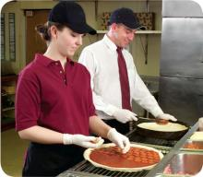
Personal Hygiene and Contamination
Managers must focus on the following:
  Establishing specific personal hygiene policies
  Training food handlers on personal hygiene policies and retraining them regularly
  Modeling correct behavior at all times
  Supervising food safety practices
  Revising personal hygiene policies when laws or science change
4-2
Notes:
Instructor Notes
Good personal hygiene is a critical protective measure against foodborne illness. As a manager, you can minimize the risk of foodborne illness by carrying out the responsibilities highlighted in the slide.

Slide 3

How Food Handlers Can Contaminate Food
Food handlers can contaminate food when they:
  Have a foodborne illness
  Have symptoms such as diarrhea, vomiting, or jaundice—a yellowing of the eyes or skin
  Have wounds that contain a pathogen
  Sneeze or cough
  Have contact with a person who is sick
  Touch anything that may contaminate their hands and do not wash them
4-3
Notes:
Instructor Notes
With some illnesses, a person may infect others before showing symptoms. For example, a person could spread hepatitis A for weeks before having any symptoms.
With other illnesses, such as Norovirus, a person may infect others for days or even months after symptoms are gone.
Some people also carry pathogens and infect others without getting sick themselves. These people are called carriers. The bacteria Staphylococcus aureus is carried in the nose of 30 to 50 percent of healthy adults. About 20 to 35 percent of healthy adults carry it on their skin. Food handlers transfer this type of bacteria to food when they touch the infected areas of their bodies and then touch food without washing their hands.

Slide 4
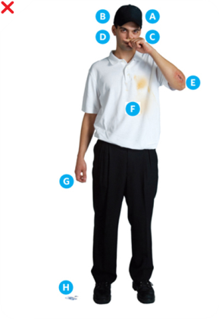
How Food Handlers Can Contaminate Food
Actions that can contaminate food:
A. Scratching the scalp
B. Running fingers through hair
C. Wiping or touching the nose
D. Rubbing an ear
E. Touching a pimple or
infected wound
F. Wearing a dirty uniform
G. Coughing or sneezing into the hand
H. Spitting in the operation
4-4
Notes:
Instructor Notes
Simple acts can contaminate food. For this reason, food handlers need to monitor what they do with their hands.

Slide 5
A Good Personal Hygiene Program
Good personal hygiene includes:
  Following hygienic hand practices
  Maintaining personal cleanliness
  Wearing clean and appropriate clothing, restraining hair, and removing jewelry
  Avoiding unsanitary habits and actions
  Maintaining good health
  Covering wounds
  Reporting health issues
4-5
Notes:
Instructor Notes
A personal hygiene program should include hygiene policies that address the topics highlighted in the slide.
Train your staff on these policies and enforce them.

Slide 6
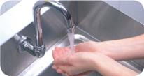
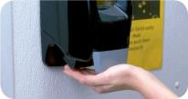
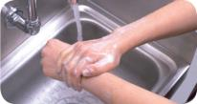
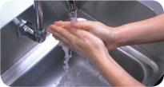
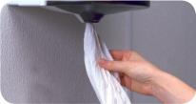
Handwashing
How to wash hands (should take at least 20 seconds):
Wet hands and arms. Use running water as hot as you can comfortably stand. It should be at least 100˚F (38˚C).
2. Apply soap. Apply enough to build up a good lather.
3. Scrub hands and arms vigorously. Scrub them for 10 to 15 seconds. Clean under fingernails and between fingers.
4. Rinse hands and arms thoroughly. Use running warm water.
5. Dry hands and arms. Use a single-use paper towel or hand dryer. Consider using a paper towel to turn off the faucet and open the restroom door.
4-6
Notes:
Instructor Notes
Handwashing is the most important part of personal hygiene. It may seem like an obvious thing to do. Even so, many food handlers do not wash their hands correctly or as often as they should.
You must train your food handlers to wash their hands, and then you must monitor them.
Hands need to be washed in a sink designated for handwashing. Do not wash hands in sinks for food prep, dishwashing, or utility services.

Slide 7
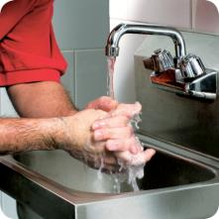
When to Wash Hands
Food handlers must wash their hands before they start work and after:
  Using the restroom
  Handling raw meat, poultry, and
  seafood (before and after)
  Touching the hair, face, or body
  Sneezing, coughing, or using
  a tissue
  Eating, drinking, smoking, or chewing gum or tobacco
  Handling chemicals that might
  affect food safety
4-7

Slide 8
When to Wash Hands
Food handlers must wash their hands after:
  Taking out garbage
  Clearing tables or busing dirty dishes
  Touching clothing or aprons
  Handling money
  Leaving and returning to the kitchen/prep area
  Handling service animals or aquatic animals
  Touching anything else that may contaminate hands
4-8

Slide 9
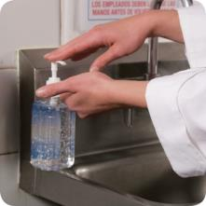
Hand Antiseptics
Hand antiseptics:
  Liquids or gels used to lower the number
  of pathogens on skin
  Must comply with the CFR and
  FDA standards
  Should be used only after handwashing
  Must NEVER be used in place of handwashing
  Should be allowed to dry before touching food or equipment
4-9

Slide 10
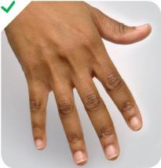
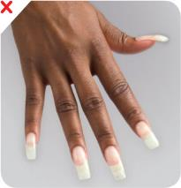
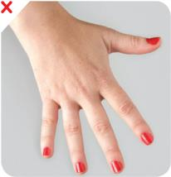
Hand Care
Requirements for food handlers:
Keep fingernails
short and clean
Do NOT wear
false nails
Do NOT wear
nail polish
4-10
Notes:
Instructor Notes
Long fingernails may be hard to keep clean and can rip gloves. They can also chip and become physical contaminants.
Fingernails should be kept trimmed and filed. This will allow nails to be cleaned easily. Ragged nails can be hard to keep clean. They may also hold pathogens and break off—becoming physical contaminants.
Do not wear false fingernails. They can be hard to keep clean. False fingernails also can break off into food. Some local regulatory authorities allow false nails if single-use gloves are worn.
Do not wear nail polish. It can disguise dirt under nails and may flake off into food. Some regulatory authorities allow polished nails if single-use gloves are worn.

Slide 11
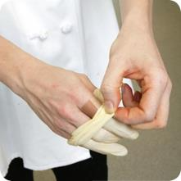
Hand Care
Infected wounds or cuts:
  Contain pus
  Must be covered to prevent pathogens
  from contaminating food and food-contact surfaces
How a wound is covered depends on
where it is located:
  Cover wounds on the hand or wrist with an
  impermeable cover, (i.e. bandage or finger cot) and
  then a single-use glove
  Cover wounds on the arm with an impermeable cover,
  such as a bandage
  Cover wounds on other parts of the body with a dry,
  tight-fitting bandage
4-11
Notes:
Instructor Notes
An impermeable cover does not allow liquid to pass through the cover.

Slide 12
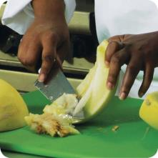
Bare-Hand Contact with Ready-to-Eat Food
Bare-hand contact with ready-to-eat food must be avoided except when:
  The food is an ingredient in a dish that does not contain raw meat, seafood, or poultry
    The dish will be cooked to at least 145˚F (63˚C)
  The food is an ingredient in a dish containing raw meat, seafood, or poultry
  The dish will be cooked to the required minimum internal temperature of the raw item(s)
  NEVER handle ready-to-eat food with bare hands when you primarily serve a high-risk population
4-12
Notes:
Instructor Notes
Food can become contaminated when it has been handled with bare hands. This is especially true when hands have not been washed correctly or have infected cuts or wounds. For this reason, do not handle ready-to-eat food with bare hands.
There are times when it may be acceptable to handle ready-to-eat food with bare hands. This is true in the situations identified in the slide.
Never handle ready-to-eat food with bare hands if you primarily serve a high-risk population.
Some regulatory authorities allow bare-hand contact with ready-to-eat food. If your jurisdiction allows this, you must have specific policies in place about staff health. You must also train staff in handwashing and personal hygiene practices.

Slide 13
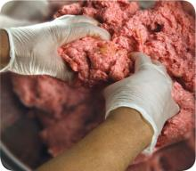
Single-Use Gloves
Single-use gloves:
  Should be used when handling
  ready-to-eat food
    Except when washing produce
    Except when handling ready-to-eat ingredients for a dish that will be cooked
  Must NEVER be used in place
  of handwashing
  Must NEVER be washed and reused
  Must fit correctly
4-13
Notes:
Instructor Notes
Single-use gloves can help keep food safe by creating a barrier between hands and food. Gloves should be worn when handling ready-to-eat food. The exceptions include when washing produce, or when handling ready-to-eat ingredients for a dish that will be cooked to the correct internal temperature.
Make sure you provide different glove sizes. Gloves that are too big will not stay on. Those that are too small will tear or rip easily.
Some food handlers and customers may be sensitive to latex. Consider providing gloves made from other materials.

Slide 14
Single-Use Gloves
How to use gloves:
  Wash and dry hands before putting gloves on when starting a new task
  Choose the correct glove size
  Hold gloves by the edge when putting them on
  Once gloves are on, check for rips or tears
  Do NOT blow into gloves
  Do NOT roll gloves to make them easier to put on
4-14
Notes:
Instructor Notes
Wash your hands before putting gloves on when starting a new task. You do not need to rewash your hands each time you change gloves as long as you are performing the same task, and your hands have not become contaminated.
Avoid contaminating gloves when putting them on.

Slide 15
Single-Use Gloves
When to change gloves:
  As soon as they become dirty or torn
  Before beginning a different task
  After an interruption, such as taking a phone call
  After handling raw meat, seafood, or poultry and before handling ready-to-eat food
4-15
Notes:
Instructor Notes
Gloves can give food handlers a false sense of security, especially if they are not changed as often as they should be. Reinforce correct glove use with all food handlers.

Slide 16

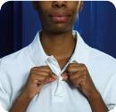
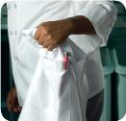
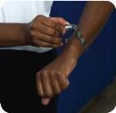
Correct Work Attire
Food handlers must:
  Wear a clean hat or other
  hair restraint
  Wear clean clothing daily
  Remove aprons when leaving food-preparation areas
  Remove jewelry from hands and arms before prepping food or when working around prep areas
4-16
Notes:
Instructor Notes
A hair restraint will keep hair away from food and keep the food handler from touching it. Do not wear hair accessories that could become physical contaminants. Hair restraints should be limited to items that keep hands out of hair, and hair out of food. Food handlers with facial hair should wear a beard restraint.
False eyelashes can become physical contaminants and should not be worn.
If possible, food handlers should change into work clothes at work. Dirty clothing stored in the operation must be kept away from food and prep areas. You can do this by placing them in nonabsorbent containers or washable laundry bags. This includes dirty aprons, chef coats, and uniforms.
Never wipe your hands on aprons.
Food handlers must remove jewelry from hands and arms when preparing food and when working around prep areas. That includes rings (except for a plain band), bracelets (including medical bracelets), and watches. Companies may also require food handlers to remove other types of jewelry. This may include earrings, necklaces, and facial jewelry. Servers may wear jewelry if allowed by company policy.

Slide 17
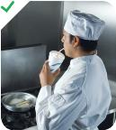
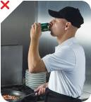
Eating, Drinking, Smoking, and Chewing Gum or Tobacco
Food handlers must not:
  Eat, drink, smoke, or chew gum or tobacco
When:
  Prepping or serving food
  Working in prep areas
  Working in areas used to clean utensils and equipment
4-17
Notes:
Instructor Notes
Small droplets of saliva can contain thousands of pathogens. In the process of eating, drinking, smoking, or chewing gum or tobacco, saliva can be transferred to hands or directly to food being handled. That’s why food handlers must not eat, drink, smoke, or chew gum or tobacco when performing the tasks indicated in the slide.
Some regulatory authorities allow food handlers to drink from a covered container while in prep and dishwashing areas.

Slide 18
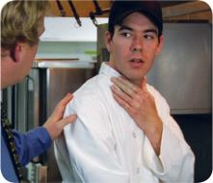
Reporting Health Issues
  If:
  The food handler has a sore throat with a fever
Then:
  Restrict the food handler from working with or around food
  Exclude the food handler from the operation if you primarily serve a high-risk population
  A written release from a medical practitioner is required before returning to work
4-18
Notes:
Instructor Notes
You must encourage your staff to report any health problems before they come to work. This includes newly hired staff who haven’t started working yet.
Staff should also let you know immediately if they get sick while working. Your regulatory authority may ask you to prove you have made staff aware of this policy.
When food handlers are sick, you may need to restrict them from working with or around food. Sometimes, you may need to exclude them from working in the operation.

Slide 19

Reporting Health Issues
  If:
  The food handler has at least one of these symptoms
  Vomiting
  Diarrhea
  Then:
Exclude the food handler from the operation
  Before returning to work, food handlers who vomited
  or had diarrhea must meet one of these requirements
    Have had no symptoms for at least 24 hours
    Have a written release from a medical practitioner
4-19

Slide 20
Reporting Health Issues
If:
  The food handler has jaundice
Then:
  Report the food handler to the regulatory authority
  Exclude food handlers from the operation if they have jaundice for seven days or less
  Food handlers must have a written release from a
  medical practitioner and approval from the regulatory authority before returning to work
4-20

Slide 21
Reporting Health Issues
  If:
  The food handler is vomiting or has diarrhea and has been diagnosed with an illness caused by one of these pathogens
  Nontyphoidal Salmonella
  Shiga toxin-producing E. coli
  Norovirus
  Shigella spp.
  Then:
  Exclude the food handler from the operation
  Work with the food handler’s medical practitioner and/or the local regulatory authority to decide when the person can go back to work
4-21
Notes:
Instructor Notes
Some food handlers diagnosed with these foodborne illnesses may not experience the usual signs or their symptoms may be over. Work with the local regulatory authority to determine whether the food handler must be excluded from the operation or restricted from working with or around food, and when the exclusion or restriction can be removed.
Remember these are only guidelines, working with your regulatory authority will help you determine the best course of action.

Slide 22
Handling Staff Illnesses
  If:
  The food handler has been diagnosed with an illness caused by one of these pathogens
  Hepatitis A
  Salmonella Typhi
  Then:
  Exclude the food handler from the operation
  Work with the food handler’s medical practitioner and/or the local regulatory authority to decide when the person can go back to work
4-22
Notes:
Instructor Notes
Whether or not a food handler has symptoms, those diagnosed with a disease caused by these pathogens must be excluded from the operation. Work with the local regulatory authority to determine when the exclusion can be removed.
Remember these are only guidelines, working with your regulatory authority will help you determine the best course of action.

Slide 24
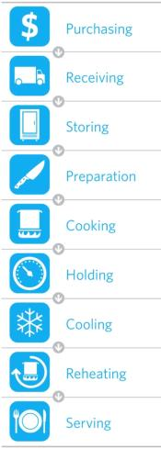
The Flow of Food
To keep food safe throughout the flow of food:
  Prevent cross-contamination
  Prevent time-temperature abuse
5-2
Notes:
Instructor Notes
Many things can happen to food as it moves from purchasing and receiving through storing, prepping, cooking, holding, cooling, reheating, and serving. This path, as shown in the slide, is the flow of food.

Slide 25
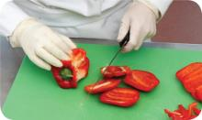
Cross-Contamination
Separate equipment:
  Use separate equipment for each type of food
Clean and sanitize:
  Clean and sanitize all work surfaces, equipment, and utensils after each task
5-3
Notes:
Instructor Notes
Each type of food should have separate equipment. For example, use one set of cutting boards, utensils, and containers for raw poultry. Use another set for raw meat. Use a third set for produce. Colored cutting boards and utensil handles can help keep equipment separate. The color tells food handlers which equipment to use with each food item. You might use yellow for raw chicken, red for raw meat, and green for produce, as the prep chef is doing in the photo.
Clean and sanitize all work surfaces, equipment, and utensils after each task. When you cut up raw chicken, for example, you cannot get by with just rinsing the equipment. Pathogens such as nontyphoidal Salmonella can contaminate food through cross-contamination. To prevent this, you must wash, rinse, and sanitize equipment.

Slide 26
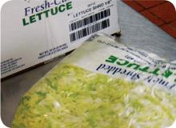
Cross-Contamination
Prep food at different times:
  Prepare raw meat, fish, and poultry at different times than ready-to-eat food (when using the same prep table)
Buy prepared food:
  Buy food items that do not require much prepping or handling
5-4
Notes:
Instructor Notes
If you need to use the same table to prep different types of food, prep raw meat, fish, and poultry; and ready-to-eat food at different times. You must clean and sanitize work surfaces and utensils between each type of food. For example, by prepping ready-to-eat food before raw food, you can minimize the chance for cross-contamination.
Buy food that doesn’t require much prepping or handling. For example, you could buy precooked chicken breasts or chopped lettuce, as shown in the photo.

Slide 27
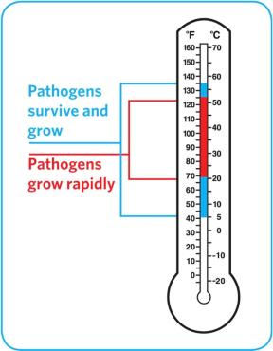
Avoiding Time-Temperature Abuse
Time-temperature control:
  Food held in the range of 41°F and 135°F (5°C and 57°C) has been time-temperature abused
  Food has been time-temperature abused whenever it is handled in the following ways
    Cooked to the wrong internal temperature
    Held at the wrong temperature
    Cooked or reheated incorrectly
5-5
Notes:
Instructor Notes
Most foodborne illnesses happen because TCS food has been time-temperature abused. Remember, TCS food has been time-temperature abused any time it remains between 41°F and 135°F (5°C and 57°C). This is called the temperature danger zone because pathogens grow in this range. But most pathogens grow especially fast between 70°F and 125°F (21°C and 52°C).
The longer food stays in the temperature danger zone, the more time pathogens have to grow. To keep food safe, you must reduce the time it spends in this temperature range. If food is held in this range for four or more hours, you must throw it out.

Slide 28
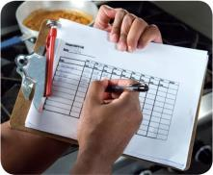
Avoiding Time-Temperature Abuse
Avoid time-temperature abuse:
  Monitor time and temperature
  Make sure the correct kinds of thermometers are available
  Regularly record temperatures and the times they are taken
  Minimize the time that food spends in the temperature danger zone
  Take corrective actions if time-temperature standards are not met
5-6
Notes:
Instructor Notes
Learn which food items should be checked, how often, and by whom. Then assign duties to food handlers in each area.
Use timers in prep areas to check how long food is in the temperature danger zone.
Have a policy limiting the amount of food that can be removed from a cooler when prepping it. This will limit the time food spends in the temperature danger zone.
Reheating soup that was being held below 135°F (57°C) is an example of a corrective action.

Slide 29
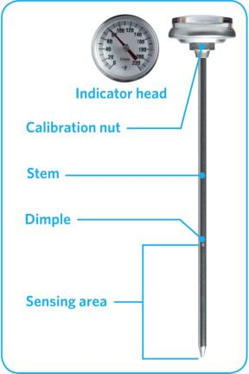
Choosing the Correct Thermometer
Bimetallic stemmed thermometer
5-7
Notes:
Instructor Notes
A bimetallic stemmed thermometer can check temperatures from 0˚F to 220˚F (–18˚C to 104˚C).
This thermometer measures temperature through its metal stem. When checking temperatures, insert the stem into the food up to the dimple. You must do this because the sensing area of the thermometer goes from the tip of the stem to the dimple. This trait makes this thermometer useful for checking the temperature of large or thick food. It is usually not practical for thin food, such as hamburger patties.
The calibration nut is used to adjust the thermometer to make it accurate.

Slide 30
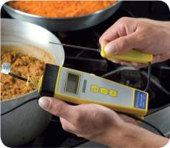
Choosing the Correct Thermometer
Thermocouples and thermistors:
  Measure temperature through a metal probe
  Display temperatures digitally
  Come with interchangeable probes
    Immersion probe
    Surface probe
    Penetration probe
    Air probe
  Have a sensing area on the tip of their probe
5-8
Notes:
Instructor Notes
The sensing area on thermocouples and thermistors is on the tip of their probe. This means you don’t have to insert them into the food as far as bimetallic stemmed thermometers to get a correct reading. Thermocouples and thermistors are good for checking the temperature of both thick and thin food.
Thermocouples and thermistors come in several styles and sizes. Many come with different types of probes.
Immersion probes are used to check the temperature of liquids such as soups, sauces, and frying oil.
Surface probes are used to check the temperature of flat cooking equipment such as griddles.
Penetration probes are used to check the internal temperature of food. Small-diameter probes should be used to check the internal temperature of thin food such as meat patties and fish fillets.
Air probes are used to check the temperature inside coolers and ovens.

Slide 31
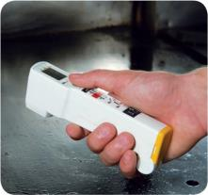
Choosing the Correct Thermometer
Infrared (laser) thermometers:
  Used to measure the surface temperature of food and equipment
  Hold as close to the food or equipment as possible
  Remove anything between the thermometer and the food, food package, or equipment
  Follow manufacturers’ guidelines
5-9
Notes:
Instructor Notes
These thermometers cannot measure air temperature or the internal temperature of food.
Hold the thermometer as close as possible to the food, food package, or equipment without touching it. Do NOT take readings through glass or metal, such as stainless steel or aluminum.
Always follow the manufacturers’ guidelines. This should give you the most accurate readings.

Slide 32
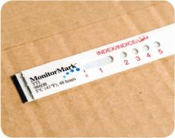
Choosing the Correct Thermometer
  Time-temperature indicators (TTI):
  Monitor both time and temperature
  Are attached to packages by the supplier
  A color change appears on the device when
  time-temperature abuse has occurred
Maximum registering thermometer:
  Indicates the highest temperature reached
  during use
  Used where temperature readings cannot
  be continuously observed
5-10
Notes:
Instructor Notes
Some devices monitor both time and temperature. The time-temperature indicator (TTI) is an example. These tags are attached to packaging by the supplier. A color change appears in the window if the food has been time-temperature abused during shipment or storage. This color change is not reversible, so you know if the food has been abused.
Some suppliers place temperature-recording devices inside their delivery trucks. These devices constantly check and record temperatures. You can check the device during receiving to make sure food was at safe temperatures while it was being shipped.
Other tools are available that can help you monitor temperature. A maximum registering thermometer is one type. This thermometer indicates the highest temperature reached during use and is used where temperature readings cannot be continuously observed. It works well for checking final rinse temperatures of dishwashing machines.

Slide 33
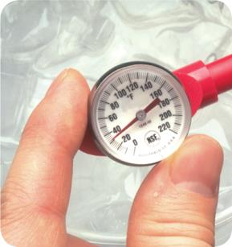
How to Calibrate Thermometers
Calibration:
  Adjusting a thermometer to get a correct reading
Two methods:
  Ice-point method
  Boiling-point method
5-11
Notes:
Instructor Notes
Thermometers can lose their accuracy when they are bumped or dropped. It can also happen when they go through severe temperature change. When this happens, the thermometer must be calibrated, or adjusted, to give a correct reading.
Most thermometers can be calibrated, but some can’t and must be replaced or sent back to the manufacturer. You should follow the manufacturer’s directions.
There are two ways to calibrate a thermometer. One is to adjust it based on the temperature at which water freezes. This is called the ice-point method. The other way is to adjust it based on the temperature at which water boils. This is called the boiling-point method. While either way works, the ice-point method is more common.

Slide 34
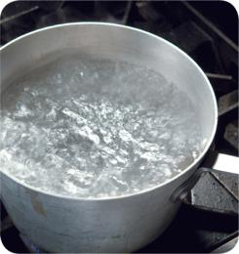
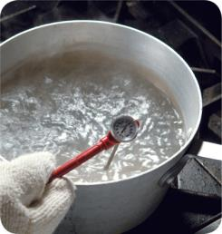
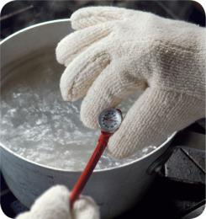
How to Calibrate Thermometers
Boiling-point method:
1. Bring tap water to a boil in a deep pan.
2. Put the thermometer stem or probe into the water.
3. Adjust the thermometer so it reads 212˚F (100˚C).
Note: Boiling point of water varies based on elevation
5-12
Notes:
Instructor Notes
Once the thermometer stem or probe is in the boiling water (make sure the sensing area is under water), wait thirty seconds, or until the indicator stops moving.
How you complete step 3 depends on the type of thermometer being used.
For a bimetallic stemmed thermometer: Hold the calibration nut with a wrench or other tool. Rotate the thermometer head until it reads 212˚F (100˚C).
For thermocouples and thermistors: Follow the manufacturer’s directions. On some devices, you can press a reset button.

Slide 35
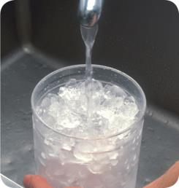
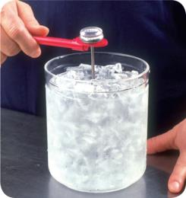

How to Calibrate Thermometers
Ice-point method:
1. Fill a large container with crushed ice and water.
2. Put the thermometer stem or probe into the water.
3. Adjust the thermometer so it reads 32˚F (0˚C).
5-13
Notes:
Instructor Notes
Once the thermometer stem or probe is in the ice water, wait thirty seconds, or until the indicator stops moving.
How you complete step 3 depends on the type of thermometer being used.
For a bimetallic stemmed thermometer: Hold the calibration nut with a wrench or other tool. Rotate the thermometer head until it reads 32˚F (0˚C).
For thermocouples and thermistors: Follow the manufacturer’s directions. On some devices, you can press a reset button.

Slide 36
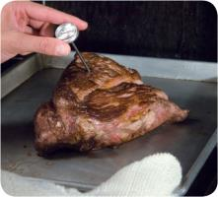
General Thermometer Guidelines
When using thermometers:
  Wash, rinse, sanitize, and air-dry thermometers before and after using them
  Calibrate them before each shift to
  ensure accuracy
  Make sure thermometers used to measure the temperature of food are accurate to
  +/- 2˚F or +/- 1˚C
  Only use glass thermometers if they are enclosed in a shatterproof casing
5-14
Notes:
Instructor Notes
Thermometers should be washed, rinsed, sanitized, and air-dried before and after each use to prevent cross-contamination. Be sure the sanitizing solution you use is for food-contact surfaces.
Make sure your thermometers are accurate by calibrating them regularly. You should do this before each shift. You should also do this before the first delivery arrives. Some thermometers cannot be calibrated and must be replaced. Others will need to be sent back to the manufacturer for calibration. Follow the manufacturer’s directions regarding calibration.
Glass thermometers, such as candy thermometers, can be a physical contaminant if they break. They can only be used when enclosed in a shatterproof casing.

Slide 37
General Thermometer Guidelines
When using thermometers:
  Insert the thermometer stem or
  probe into thickest part of the product
  (usually the center)
  Take another reading in a different spot
  Wait for the thermometer reading to steady before recording the temperature
5-15
Notes:
Instructor Notes
When checking the temperature of food, insert the probe into the thickest part of the food, as shown in the photo. This is usually in the center. Also take another reading in a different spot. The temperature may vary in different areas. Before recording a temperature, wait for the thermometer reading to steady. With bimetallic stemmed thermometers wait at least 15 seconds after you insert the stem into the food.

Slide 39
General Purchasing and Receiving Principles
Purchase food from approved, reputable suppliers:
  Have been inspected and can show an inspection report
  Meet applicable local, state, and federal laws
Arrange deliveries so they arrive:
  When staff has enough time to do inspections
  When they can be correctly received
6-2
Notes:
Instructor Notes
Food must be purchased from approved, reputable suppliers. These suppliers have been inspected and can show you an inspection report. They also meet all applicable local, state, and federal laws. This applies to all suppliers in the supply chain. Your operation’s chain can include growers, shippers, packers, manufacturers, distributors (trucking fleets and warehouses), and local markets.
Develop a relationship with your suppliers, and get to know their food safety practices. Consider reviewing their most recent inspection reports. These reports can be from the U.S. Department of Agriculture (USDA), the Food and Drug Administration (FDA), or a third-party inspector. They should be based on Good Manufacturing Practices (GMP) or Good Agricultural Practices (GAP).

Slide 40
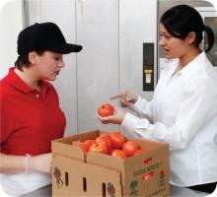
Receiving Considerations
Receiving principles:
  Make specific staff responsible for receiving
    Train them to look for
      Correct temperatures
      Expired code dates
      Signs of thawing and refreezing
      Pest damage
    Allow them to accept, reject, and sign for deliveries
  Plan ahead for shipments
6-3
Notes:
Instructor Notes
Make specific staff responsible for receiving.
Provide staff with the tools they need, including purchase orders, thermometers, and scales. Then make sure enough trained staff is available to receive and inspect food items promptly.
Plan ahead for shipments. Have clean hand trucks, carts, dollies, and containers ready. Also, make sure there is enough space in dry-storage and walk-in areas for shipments.

Slide 41
Receiving Considerations
Receiving principles:
  During the inspection
    Visually inspect truck for signs of contamination
    Check for damaged food
    Sample temperatures
    Inspect and store each delivery before inspecting another
6-4

Slide 42
Receiving Considerations
Key drop deliveries:
  Supplier is given after-hours access to the operation
  to make deliveries
  Deliveries must meet the following criteria
    Be inspected upon arrival at the operation
    Be from an approved source
    Have been placed in the correct storage location to
    maintain the required temperature
    Have been protected from contamination in storage
    Are NOT contaminated
    Be honestly presented
6-5
Notes:
Instructor Notes
Some foodservice operations receive food after-hours when they are closed for business. This is often referred to as a key drop delivery.
The supplier is given a key or other access to the operation to make the delivery. Products are then placed in coolers, freezers, and dry storage areas. The delivery must be inspected once you arrive at the operation and meet the criteria identified in the slide.

Slide 43
Receiving and Inspecting
Rejecting deliveries:
  Separate rejected items from accepted items
  Tell the delivery person what is wrong with the item
  Get a signed adjustment or credit slip before giving
  the rejected item to the delivery person
  Log the incident on the invoice or receiving document
6-6
Notes:
Instructor Notes
Occasionally you may be able to recondition and use items that would have been rejected. For example, a shipment of cans with contaminated surfaces may be cleaned and sanitized, allowing them to be used. However, the same cans may not be reconditioned if the contamination was a result of damage to the cans.

Slide 44
Receiving and Inspecting
Recalls:
  Identify the recalled food items
  Remove the item from inventory, and place it in a secure and appropriate location
  Store the item separately from food, utensils, equipment, linens, and single-use items
  Label the item in a way that will prevent it from being placed back in inventory
  Inform staff not to use the product
  Refer to the vendor’s notification or recall notice to determine what to do with the item
6-7
Notes:
Instructor Notes
Food items you have received may sometimes be recalled by the manufacturer. This may happen when food contamination is confirmed or suspected. It can also occur when items have been mislabeled or misbranded. Often food is recalled when food allergens have not been identified on the label. Most vendors will notify you of the recall. However, you should also monitor recall notifications made by the FDA and the USDA. Follow the guidelines in the slide when notified of a recall.
Identify the recalled food items by matching information from the recall notice to the item. This may include the manufacturer’s ID, the time the item was manufactured, and the item’s use-by date.
Remove the item from inventory, and place it in a secure and appropriate location. That may be a cooler or dry-storage area.
The recalled item must be stored separately from food, utensils, equipment, linens, and single-use items.
Label the item in a way that will prevent it from being placed back in inventory. Some operations do this by including a Do Not Use and Do Not Discard label on recalled food items. Inform staff not to use the product.
Refer to the vendor’s notification or recall notice for what to do with the item. For example, you might be instructed to throw it out or return it to the vendor.

Slide 45
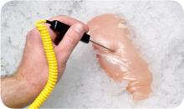
General Inspection Guidelines
Checking the temperature of meat, poultry,
and fish:
  Insert the thermometer stem or probe into the thickest part of the food (usually the center)
6-8

Slide 46
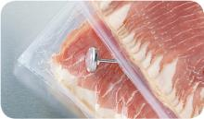
General Inspection Guidelines
Checking the temperature of reduced-oxygen packaged (ROP) food and bulk food:
  Insert the thermometer stem or probe between
  two packages
  As an alternative, fold packaging around the thermometer stem or probe
    Be careful not to puncture the packaging
6-9
Notes:
Instructor Notes
ROP stands for reduced-oxygen packaging. It includes MAP, vacuum-packed, and sous vide food.

Slide 47
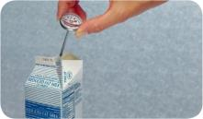
General Inspection Guidelines
Checking the temperature of other packaged food:
  Open the package and insert the thermometer stem or probe into the food
    Fully immerse the sensing area in the item
    Do not touch the package with the stem or probe
6-10

Slide 48
General Inspection Guidelines
Receiving temperature requirements:
Type of food | Temperature
Cold TCS food | 41˚F (5˚C) or lower, unless specified
Hot TCS food | 135˚F (57˚C) or higher
Frozen food | Frozen solid
Live shellfish | Air temperature of 45˚F (7˚C) Internal temperature ≤ 50˚F (10˚C) Once received, cool it to an internal temperature of 41˚F (5˚C) or lower in 4 hours
6-11

Slide 49
General Inspection Guidelines
Receiving temperature requirements:
Type of food | Temperature
Shucked shellfish | 45˚F (7˚C) or lower Must be cooled it to an internal temperature of 41˚F (5˚C) or lower in 4 hours
Milk | 45˚F (7˚C) or lower Must be cooled it to an internal temperature of 41˚F (5˚C) or lower in 4 hours
Shell eggs | Air temperature of 45˚F (7˚C) or lower
6-12

Slide 50
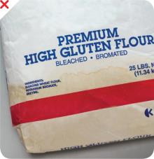
Receiving and Inspecting
Reject packaged items with:
  Tears, holes, or punctures in packaging; reject cans with swollen ends, rust, or dents
  Bloating or leaking (ROP food)
  Broken cartons or seals
  Dirty and discolored packaging
  Leaks, dampness, or water stains
  Signs of pests or pest damage
  Expired use-by/expiration dates
  Evidence of tampering
6-13
Notes:
Instructor Notes
Both food items and nonfood items such as single-use cups, utensils, and napkins, must be packaged correctly when you receive them. Items should be delivered in their original packaging with a manufacturer’s label. The packaging should be intact, clean, and protect food and food-contact surfaces from contamination. Reject food and nonfood items if packaging has any of the problems listed on the slide.

Slide 51
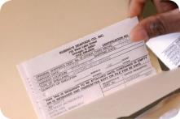
Receiving and Inspecting
Required documents:
  Shellfish must be received with shellstock identification tags
    Tags indicate when and where the shellfish were harvested
    Must be kept on file for 90 days from the date the last shellfish was used from its delivery container
6-14

Slide 52
Receiving and Inspecting
Required documents:
  Fish that will be eaten raw or partially cooked
    Documentation must show the fish was correctly frozen before being received
    Keep documents for 90 days from the sale of the fish
  Farm raised fish
    Must have documentation stating the fish was raised to FDA standards
    Keep documents for 90 days from the sale of the fish
6-15

Slide 53
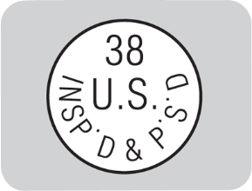
Inspection and Grading Stamps
Products requiring inspection stamps:
  Meat and poultry
    Packaging must have a USDA or state department of agriculture stamp
    Stamp indicates product and processing plant have met certain standards
  Egg products
    Liquid, frozen, and dehydrated eggs must also have a USDA inspection mark
    Grading stamps:
  Voluntary
  Paid for by processors and packers
6-16
Notes:
Instructor Notes
Checking for inspection stamps is a way to make sure food is coming from an approved source.

Slide 54
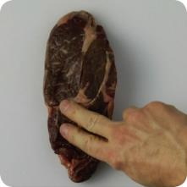
Receiving and Inspecting
Assessing food quality:
  Appearance: Reject food that is moldy or has an abnormal color
  Texture: Reject meat, fish, or poultry if
    It is slimy, sticky, or dry
    It has soft flesh that leaves an imprint when touched
  Odor: Reject food with an abnormal or unpleasant odor
6-17
Notes:
Instructor Notes
Poor food quality can be a sign that the food has been time-temperature abused and, therefore, may be unsafe.
In addition to the guidelines above, you should always reject any item that does not meet your company’s standards for quality.

Slide 56
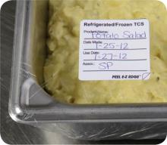
Labeling
Labeling food for use on-site:
  All items not in their original containers must be labeled
  Food labels should include the common name of the food or a statement that clearly and accurately identifies it
  It is not necessary to label food if it clearly will not be mistaken for another item
7-2
Notes:
Instructor Notes
Labeling food is important for many reasons. Illnesses have occurred when unlabeled chemicals were mistaken for food such as flour, sugar, and baking powder. Customers have also suffered allergic reactions when food was unknowingly prepped with a food allergen that was not labeled.
It is not necessary to label food if clearly it will not be mistaken for another item. The food must be easily identified by sight.

Slide 57
Labeling
Labeling food packaged on-site for retail sale:
  Common name of the food or a statement clearly identifying it
  Quantity of the food
  If the item contains two or more ingredients, list the ingredients and sub-ingredients in descending order by weight
  List of artificial colors and flavors in the food including
  chemical preservatives
  Name and place of business of the manufacturer, packer,
  or distributor
  Source of each major food allergen contained in the food
7-3
Notes:
Instructor Notes
Food packaged in the operation that is being sold to customers for use at home must be labeled. Bottled salad dressing is one example. The label must include the information on the slide.
Naming the source of each major food allergen contained in the food is not necessary if the source is already part of the common name of the ingredient.
These labeling requirements do not apply to customers’ leftover food items placed in carry-out containers.

Slide 58
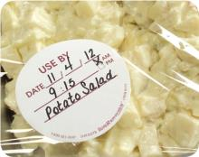
Date Marking
Date marking:
  Ready-to-eat TCS food must be marked if held for longer than 24 hours
    Date mark must indicate when the food must be sold, eaten, or thrown out
7-4
Notes:
Instructor Notes
Refrigeration slows the growth of most bacteria. Some types, such as Listeria monocytogenes, grow well at refrigeration temperatures. When food is refrigerated for long periods of time, these bacteria can grow enough to cause illness. For this reason, ready-to-eat TCS food must be marked if held for longer than 24 hours. It must indicate when the food must be sold, eaten, or thrown out.

Slide 59
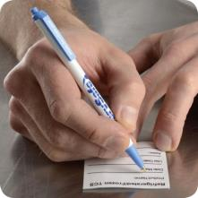
Date Marking
Date marking:
  Ready-to-eat TCS food can be stored for only seven days if it is held at 41˚F (5˚C)
  or lower
    The count begins on the day that the food was prepared or a commercial container
    was opened
    For example, potato salad prepared and stored on October 1 would have a discard date of October 7 on the label
    Some operations write the day or date the food was prepared on the label; others write the use-by day or date on the label
7-5

Slide 60
Date Marking
Commercially processed food:
  If
  A commercially processed food has a use-by date that is less
  than seven days from the date the container was opened
  Then
  The container should be marked with this use-by date
  as long as the date is based on food safety
7-6
Notes:
Instructor Notes
Operations have a variety of systems for date marking. Some write the day or date the food was prepped on the label. Others write the use-by day or date on the label.

Slide 61
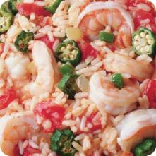
Date Marking
Combining food:
  When combining food in a dish with different
  use-by dates, the discard date of the dish should be based on the earliest prepared food
  Consider a shrimp and sausage jambalaya prepared on December 4
    The shrimp has a use-by date of December 8
    The sausage has a use-by date of December 10
    The use-by date of the jambalaya is December 8
7-7

Slide 62
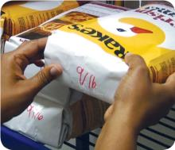
Rotation
Rotate food to use the oldest inventory first:
  One way to rotate products is to follow FIFO
    Identify the food item’s use-by or expiration date
    Store items with the earliest use-by or expiration dates in front of items with later dates
    Once shelved, use those items stored in front first
    Throw out food that has passed its manufacturer’s use-by or expiration date
7-8
Notes:
Instructor Notes
Food must be rotated in storage to maintain quality and limit the growth of pathogens. Food items must be rotated so that those with the earliest use-by or expiration dates are used before items with later dates.
Many operations use the first-in, first-out (FIFO) method to rotate their refrigerated, frozen, and dry food during storage. Here is one way to use the FIFO method.

Slide 63
Temperatures
Temperature guidelines:
  Store TCS food at an internal temperature
  of 41˚F (5˚C) or lower, or 135˚F (57˚C)
  or higher
  Store frozen food at temperatures that keep it frozen
  Make sure storage units have at least one air temperature measuring device; it must be accurate to +/- 3˚F or +/- 1.5˚C
    Place the device in the warmest part of refrigerated units, and the coldest part of hot-holding units
7-9
Notes:
Instructor Notes
Pathogens can grow when food is not stored at the correct temperature. Follow the guidelines on the slide to keep food safe.
Randomly sample the internal temperature of stored food on a regular basis.
Store meat, poultry, seafood, and dairy items in the coldest part of the unit, away from the door.
Air temperature measuring devices must be located in the warmest part of refrigeration units.

Slide 64
Temperatures
Temperatures guidelines:
  Do not overload coolers or freezers
    Prevents airflow
    Makes units work harder to stay cold
  Use open shelving
    Do not line shelves as this restricts airflow
7-10

Slide 65
Storage Location
Food should be stored in a clean, dry location away from dust and other contaminants:
  To prevent contamination, NEVER store food in these areas
    Locker rooms or dressing rooms
    Restrooms or garbage rooms
    Mechanical rooms
    Under unshielded sewer lines or leaking water lines
    Under stairwells
7-11

Slide 66

Preventing Cross-Contamination
Supplies:
  Store all items in designated storage areas
    Store items away from walls and at least
    six inches (15 centimeters) off the floor
    Store single-use items (e.g., sleeve of
    single-use cups, single-use gloves) in
    original packaging
7-12

Slide 67

Preventing Cross-Contamination
Containers:
  Store food in containers intended for food
  Use containers that are durable, leak proof, and able to be sealed or covered
  NEVER use empty food containers to store chemicals; NEVER put food in empty chemical containers
7-13
Notes:
Instructor Notes
Wrap or cover all food correctly. Leaving food uncovered can lead to cross-contamination.

Slide 68

Preventing Cross-Contamination
Cleaning:
  Keep all storage areas clean and dry
  Clean up spills and leaks immediately
  Clean dollies, carts, transporters, and trays often
  Store food in containers that have been cleaned and sanitized
  Store dirty linens in clean, nonabsorbent containers or washable laundry bags
7-14
Notes:
Instructor Notes
Keep all storage areas clean and dry. Clean floors, walls, and shelving in coolers, freezers, dry-storage areas, and heated holding cabinets on a regular basis.
Clean up spills and leaks promptly to keep them from contaminating other food.
• Store dirty linens away from food.

Slide 69

Preventing Cross-Contamination
Storage order:
  Store food items in the following
  top-to-bottom order
    Ready-to-eat food
    Seafood
    Whole cuts of beef and pork
    Ground meat and ground fish
    Whole and ground poultry
  This storage order is based on the minimum internal cooking temperature of each food
7-15
Notes:
Instructor Notes
Raw meat, poultry, and seafood can be stored with or above ready-to-eat food in a freezer if all of the items have been commercially processed and packaged.
Frozen food that is being thawed in coolers must also be stored below ready-to-eat food.
As an exception, ground meat and ground fish can be stored above whole cuts of beef and pork. To do this, make sure the packaging keeps out pathogens and chemicals. It also must not leak.

Slide 71

General Preparation Practices
When prepping food:
  Make sure workstations, cutting boards, and utensils are clean and sanitized
  Only remove as much food from the cooler as you can prep in a short period of time
    This limits time-temperature abuse
  Return prepped food to the cooler or cook it as quickly as possible
8-2

Slide 72
General Preparation Practices
Food and color additives:
  Only use additives approved by your local regulatory authority
  NEVER use more additives than are allowed by law
  NEVER use additives to alter the appearance of food
  Do NOT sell produce treated with sulfites before it was received in the operation
  Do NOT add sulfites to produce that will be eaten raw
8-3

Slide 73
General Preparation Practices
Present food honestly:
  Do NOT use the following to misrepresent the appearance of food
    Food additives or color additives
    Colored overwraps
    Lights
  Food not presented honestly must be thrown out
8-4
Notes:
Instructor Notes
Food must be offered to customers in a way that does not mislead or misinform them. Customers must be able to judge the true appearance, color, and quality of food.

Slide 74
General Preparation Practices
Corrective actions:
  Food must be thrown out in the following situations
    When it is handled by staff who have been restricted or excluded from the operation due to illness
    When it is contaminated by hands or bodily fluids from the nose or mouth
    When it has exceeded the time and temperature requirements designed to keep food safe
8-5
Notes:
Instructor Notes
• Food that has become unsafe must be thrown out unless it can be safely reconditioned. All food—especially ready-to-eat food—must be thrown out in the situations highlighted in the slide.
• Sometimes food can be restored to a safe condition. This is called reconditioning. For example, a hot food that has not been held at the correct temperature may be reheated if it has not been in the temperature danger zone for more than two hours.

Slide 75

Thawing
Four methods for thawing food:
  Thaw food in a cooler, keeping its temperature at 41˚F (5˚C) or lower
  Submerge food under running drinkable water at 70˚F (21˚C) or lower
    Never let the temperature of the food go above 41˚F (5˚C) or lower for longer than four hours
  Thaw food in a microwave, only if cooked immediately after thawing
  Thaw as part of the cooking process
8-6
Notes:
Instructor Notes
When frozen food is thawed and exposed to the temperature danger zone, pathogens in the food will begin to grow. To reduce this growth, never thaw food at room temperature.
When thawing food under running water, the flow of the water must be strong enough to wash loose food into the drain. Always use a clean and sanitized food-prep sink when thawing food this way. Never let the temperature of the food go above 41°F (5°C) for longer than four hours. This includes the time it takes to thaw the food plus the time it takes to prep or cool it. The photo shows the correct way to thaw food under running water.
After food is thawed in a microwave oven, it must be cooked in conventional cooking equipment, such as an oven.
Some food can be slacked before cooking. Slacking is the gradual thawing of frozen food to prep it for deep-frying. This allows even heating during cooking. Slack food just before you cook it. Do not let it get any warmer than 41°F (5°C). If your regulatory authority allows slacking at room temperature, have a system that ensures the item does not exceed 41°F (5°C).

Slide 76

Thawing ROP Fish
  Frozen fish received in ROP packaging
  must be thawed carefully.
  If the label states that the product must remain frozen until use, then remove fish from packaging:
    Before thawing under refrigeration.
    Before or immediately after thawing
    under running water.
8-7
Notes:
Instructor Notes
Because of concerns about the potential for Botulism, frozen fish in ROP packaging has special handling practices.

Slide 77
Prepping Specific Food
When prepping meat, seafood, poultry:
  Use clean and sanitized work areas, cutting boards, knives, and utensils
  Prep these items separately or at different times from produce
  Remove only as much product as can be prepped at one time
  Return raw product to the cooler as quickly as possible after prepping it
8-8

Slide 78

Prepping Specific Food
When prepping salads containing
TCS food:
  Prep the food in small batches
  Make sure leftover TCS ingredients (i.e., pasta, chicken, potatoes) have been handled safely by ensuring that they were
    Cooked, held, and cooled correctly
    Stored for less than seven days at 41˚F (5˚C) or lower
8-9
Notes:
Instructor Notes
Chicken, tuna, egg, pasta, and potato salads all have been involved in foodborne-illness outbreaks. These salads usually are not cooked after preparation. This means you do not have a chance to reduce pathogens, such as Staphylococcus aureus, that may have gotten into the salad during preparation.
Check the use-by date before using leftover TCS food in salads.

Slide 79
Prepping Specific Food
When prepping salads containing
TCS food:
  Consider chilling ingredients and utensils before use
  Leave food in the cooler until all ingredients will be mixed
8-10

Slide 80

Prepping Specific Food
When prepping eggs and egg mixtures:
  Handle pooled eggs (if allowed)
  with care
    Cook promptly after mixing or store at 41˚F (5˚C) or lower
    Wash and sanitize containers between batches
  Consider using pasteurized shell eggs or egg products when prepping dishes that need little or no cooking
  Promptly clean and sanitize equipment used to prep eggs
8-11
Notes:
Instructor Notes
Pooled eggs are eggs that are cracked open and combined in a container.
Check with your local regulatory authority to see if pooling eggs is allowed.
Egg dishes requiring little or no cooking include: Caesar salad dressing, Hollandaise sauce, tiramisu, and mousse.

Slide 81
Prepping Specific Food
When prepping eggs for high-risk populations:
  Use pasteurized eggs or egg products when serving raw or undercooked dishes
    Unpasteurized shell eggs can be used if the dish will be cooked all the way through (i.e., omelets, cakes)
  Use pasteurized shell eggs if eggs will be pooled
8-12

Slide 82

Prepping Specific Food
When prepping breaded or battered food:
  Prep batter in small batches
  Store unused batter as quickly as possible
  Throw out unused batter or breading after a set amount of time
  Do not overload fryer baskets; make sure items are cooked all of the way through
8-13
Notes:
Instructor Notes
Batters or breading prepped with eggs or milk run the risk of time-temperature abuse and cross-contamination.
If you have leftover batter, store what you don’t need at 41°F (5°C) or lower in a covered container.
Create a plan to throw out any unused batter or breading after at set time. This might be after using a batch or at the end of a shift.

Slide 83

Prepping Specific Food
To package fresh juice for later sale:
  The juice must be treated
  (e.g., pasteurized) according
  to an approved HACCP plan
  As an alternative, the juice must be labeled as specified by federal regulation
8-14

Slide 84

Prepping Specific Food
Produce:
  Make sure produce does not touch surfaces exposed to raw meat, seafood, or poultry
  Wash it thoroughly under running water before
    Cutting
    Cooking
    Combining with other ingredients
8-15
Notes:
Instructor Notes
Wash produce thoroughly under running water. This is especially important before cutting, cooking, or combining it with other ingredients. The water should be a little warmer than the produce.
Pay special attention to leafy greens such as lettuce and spinach. Remove the outer leaves, and pull the lettuce or spinach completely apart and rinse thoroughly.

Slide 85

Prepping Specific Food
Produce:
  Produce can be washed in water containing ozone to sanitize it
    Check with your local regulatory authority
  When soaking or storing produce in standing water or an ice-water slurry, do NOT mix
    Different items
    Multiple batches of the same item
8-16
Notes:
Instructor Notes
Certain chemicals may be used to wash fruits and vegetables. Also, produce can be treated by washing it in water containing ozone. This treatment helps control pathogens. Check your local regulatory requirements.

Slide 86
Prepping Specific Food
Produce:
  Refrigerate and hold sliced melons,
  cut tomatoes, and cut leafy greens at
  41˚F (5˚C) or lower
  Do NOT serve raw seed sprouts if primarily serving a high-risk population
8-17

Slide 87

Prepping Specific Food
Ice:
  NEVER use ice as an ingredient if it was used to keep food cold
  Transfer ice using clean and sanitized containers and scoops
  NEVER transfer ice in containers that held chemicals or raw meat, seafood, or poultry
8-18
Notes:
Instructor Notes
Make ice from water that is safe to drink.
Never use ice as an ingredient if it was used to keep food cold. For example, if ice is used to cool food on a salad bar, it cannot then be used in drinks.

Slide 88
Prepping Specific Food
Ice:
  Store ice scoops outside ice machines in a clean, protected location
  NEVER use a glass to scoop ice or touch ice with hands
8-19

Slide 89

Preparation Practices That Have Special Requirements
You need a variance if prepping food in these ways:
  Packaging fresh juice on-site for sale at a later time, unless the juice has a warning label
  Smoking food to preserve it but not to
  enhance flavor
  Using food additives or components to preserve or alter food so it no longer needs time and temperature control for safety
  Curing food
8-20
Notes:
Instructor Notes
You will need a variance when prepping food in certain ways. A variance is a document issued by your regulatory authority that allows a regulatory requirement to be waived or changed.
When applying for a variance, your regulatory authority may require you to submit a HACCP plan. The plan must account for any food safety risks related to the way you plan to prep the food item.

Slide 90

Preparation Practices That Have Special Requirements
You need a variance if prepping food in these ways:
  Packaging food using a reduced-oxygen packaging (ROP) method
  Sprouting seeds or beans
  Offering live shellfish from a display tank
  Custom-processing animals for personal use (i.e. dressing a deer)
8-21
Notes:
Instructor Notes
Clostridium botulinum and Listeria monocytogenes are risks to food packaged using a reduced-oxygen packaging method. This includes MAP, vacuum-packed and sous vide foods.

Slide 91

Minimum Internal Cooking Temperatures
Minimum internal cooking temperature:
165˚F (74˚C) for 15 seconds
  Poultry—whole or ground chicken, turkey, or duck
  Stuffing made with fish, meat, or poultry
  Stuffed meat, seafood, poultry, or pasta
  Dishes that include previously cooked, TCS ingredients
8-22

Slide 92

Minimum Internal Cooking Temperatures
Minimum internal cooking temperature:
155˚F (68˚C) for 15 seconds
  Ground meat—beef, pork, and other meat
  Injected meat—including brined ham and flavor-injected roasts
  Mechanically tenderized meat
  Ratites including ostrich and emu
  Ground seafood—including chopped or minced seafood
  Shell eggs that will be hot-held for service
8-23

Slide 93

Minimum Internal Cooking Temperatures
Minimum internal cooking temperature:
145˚F (63˚C) for 15 seconds
  Seafood—including fish, shellfish, and crustaceans
  Steaks/chops of pork, beef, veal, and lamb
  Commercially raised game
  Shell eggs that will be served immediately
8-24

Slide 94

Minimum Internal Cooking Temperatures
Minimum internal cooking temperature:
145˚F (63˚C) for four minutes
  Roasts of pork, beef, veal, and lamb
  Alternate cooking times/temperatures
    130˚F (54˚C) 112 minutes
    131˚F (55˚C) 89 minutes
    133˚F (56˚C) 56 minutes
    135˚F (57˚C) 36 minutes
    136˚F (58˚C) 28 minutes
    138˚F (59˚C) 18 minutes
    140˚F (60˚C) 12 minutes
    142˚F (61˚C) 8 minutes
    144˚F (62˚C) 5 minutes
8-25
Notes:
Instructor Notes
Roasts may be cooked to these alternate cooking times and temperatures depending on the type of roast and oven used:
130°F (54°C) 112 minutes
131°F (55°C) 89 minutes
133°F (56°C) 56 minutes
135°F (57°C) 36 minutes
136°F (58°C) 28 minutes
138°F (59°C) 18 minutes
140°F (60°C) 12 minutes
142°F (61°C) 8 minutes
144°F (62°C) 5 minutes

Slide 95

Minimum Internal Cooking Temperatures
Minimum internal cooking temperature:
135˚F (57˚C)
  Fruit, vegetables, grains (rice, pasta), and legumes (beans, refried beans) that will be hot-held for service
8-26

Slide 96

Cooking TCS Food in the Microwave Oven
Minimum internal cooking temperature:
165˚F (74˚C)
  Meat
  Seafood
  Poultry
  Eggs
8-27

Slide 97
Cooking TCS Food in the Microwave Oven
Guidelines for microwave cooking:
  Cover food to prevent the surface from drying out
  Rotate or stir it halfway through cooking so heat reaches the food more evenly
  Let it stand for at least two minutes after cooking to let the food temperature even out
  Check the temperature in at least two places to make sure the food is cooked through
8-28

Slide 98

Consumer Advisories
If your menu includes raw or undercooked TCS items, you must:
  Note it on the menu next to the items
    Asterisk the item
    Place a footnote at the menu bottom indicating the item is raw, undercooked, or contains raw or undercooked ingredients
  Advise customers who order this food of the increased risk of foodborne illness
    Post a notice in the menu
    Provide this information using brochures, table tents, or signs
8-29
Notes:
Instructor Notes
If your menu includes TCS items that are raw or undercooked, you must note it on the menu next to these items. This can be done by placing an asterisk next to the item that points customers to a footnote at the bottom of the menu. The footnote must include a statement that indicates the item is raw or undercooked, or contains raw or undercooked ingredients.
You must advise customers who order food that is raw or undercooked of the increased risk of foodborne illness. You can do this by posting a notice in your menu. You can also provide this information using brochures, table tents, signs, or other written methods.

Slide 99

Consumer Advisories
The FDA advises against offering these items on a children’s menu if they are raw or undercooked:
  Meat
  Poultry
  Seafood
  Eggs
8-30
Notes:
Instructor Notes
The Food and Drug Administration (FDA) advises against offering raw or undercooked meat, poultry, seafood, or eggs on a children’s menu. This is especially true for undercooked ground beef, which may be contaminated with shiga toxin-producing E. coli O157:H7.

Slide 100

Partial Cooking During Prepping
If partially cooking meat, seafood, poultry, or eggs or dishes containing these items:
  NEVER cook the food longer than
  60 minutes during initial cooking
  Cool the food immediately after
  initial cooking
  Freeze or refrigerate the food after cooling it
  Heat the food to its required minimum internal temperature before selling or serving it
  Cool the food if it will not be served immediately or held for service
8-31
Notes:
Instructor Notes
Some operations partially cook food during prep and then finish cooking it just before service. You must follow the steps in the slide if you plan to partially cook meat, seafood, poultry, or eggs; or dishes containing these items.
Your local regulatory authority may require you to have written procedures that explain how the food cooked by this process will be prepped and stored. These procedures must be approved by the regulatory authority and describe the following:
How the requirements will be monitored and documented
Which corrective actions will be taken if requirements are not met
How these food items will be marked after initial cooking to indicate that they need further cooking
How these food items will be separated from ready-to-eat food during storage, once initial cooking is complete

Slide 101


Temperature Requirements for Cooling Food
Cooling requirements:
8-32
Notes:
Instructor Notes
As you know, pathogens grow well in the temperature danger zone. However, they grow much faster at temperatures between 125°F and 70°F (52°C and 21°C). Food must pass through this temperature range quickly to reduce this growth.
Cool TCS food from 135°F (57°C) to 41°F (5°C) or lower within six hours.
First, cool food from 135˚F to 70˚F (57˚C to 21˚C) within two hours.
Then cool it to 41˚F (5˚C) or lower in the next four hours.
If food has not reached 70˚F (21˚C) within two hours, it must be reheated and then cooled again.

Slide 102
Temperature Requirements for Cooling Food
If you cool food from 135˚F to 70˚F (57˚C to 21˚C)
in less than two hours:
  Use the remaining time to cool it to 41˚F (5˚C) or lower
  The total cooling time cannot be longer than six hours
Example:
  If you cool food from 135˚F to 70˚F (57˚C to 21˚C) in one hour
  Then you have five hours to get the food to 41˚F (5˚C) or lower
8-33

Slide 103

Methods for Cooling Food
Before cooling food, start by reducing its size:
  Cut larger items into smaller pieces
  Divide large containers of food into smaller containers or shallow pans
8-34
Notes:
Instructor Notes
The denser the food, the more slowly it will cool.
Large food items cool more slowly than smaller items. To let food cool faster, you should reduce its size. Cut large food items into smaller pieces. Divide large containers of food into smaller containers or shallow pans.

Slide 104



Methods for Cooling Food
Methods for cooling food safely and quickly:
  Place food in an ice-water bath
  Stir it with an ice paddle
  Place it in a blast chiller or tumble chiller
  Use ice or cold water as an ingredient
8-35
Notes:
Instructor Notes
Never cool large amounts of hot food in a cooler. Most coolers are not designed to cool large amounts of hot food quickly. Also, placing hot food in a cooler may not move the food through the temperature danger zone quickly enough.
After dividing food into smaller containers, place them in a clean prep sink or large pot filled with ice water. Stir the food frequently to cool it faster and more evenly.
Ice paddles are plastic paddles that can be filled with ice or with water and then frozen. Food stirred with these paddles will cool quickly.
Blast chillers blast cold air across food at high speeds to remove heat. They are typically used to cool large amounts of food. Tumble chillers tumble bags of hot food in cold water.
When cooling soups or stews you can add ice or cold water as an ingredient to cool it. To use this method the recipe is made with less water than required. Cold water or ice is then added after cooking to cool the food and provide the remaining water.

Slide 105
Storing Food for Further Cooling
When storing food for further cooling:
  Loosely cover food containers before storing them
  Food can be left uncovered if protected from contamination
    Storing uncovered containers above other food, especially raw seafood, meat, and poultry, will help prevent cross-contamination
8-36
Notes:
Instructor Notes
Loosely cover food containers before storing them. Food can be left uncovered if stored in a way that prevents contaminants from getting into it. Storing uncovered containers above other food, especially raw seafood, meat, and poultry, will help prevent cross-contamination.

Slide 106

Reheating Food
Food reheated for immediate service:
  Can be reheated to any temperature if it was cooked and cooled correctly
Food reheated for hot-holding:
  Must be reheated to an internal temperature of 165˚F (74˚C) for 15 seconds within two hours
  Reheat commercially processed and packaged ready-to-eat food to an internal temperature of at least 135˚F (57˚C)
8-37
Notes:
Instructor Notes
These guidelines apply to all heating methods, such as ovens or microwave ovens.

